Slide 1
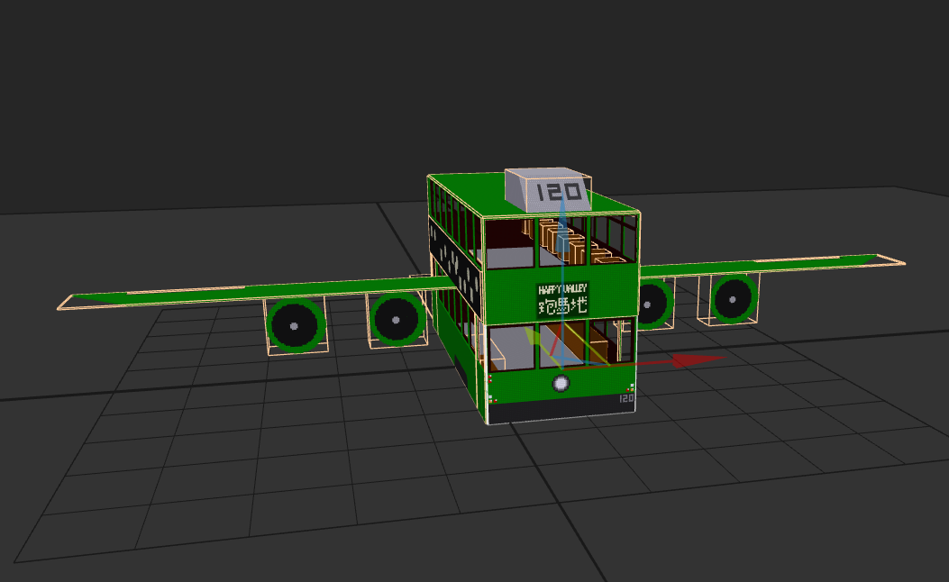
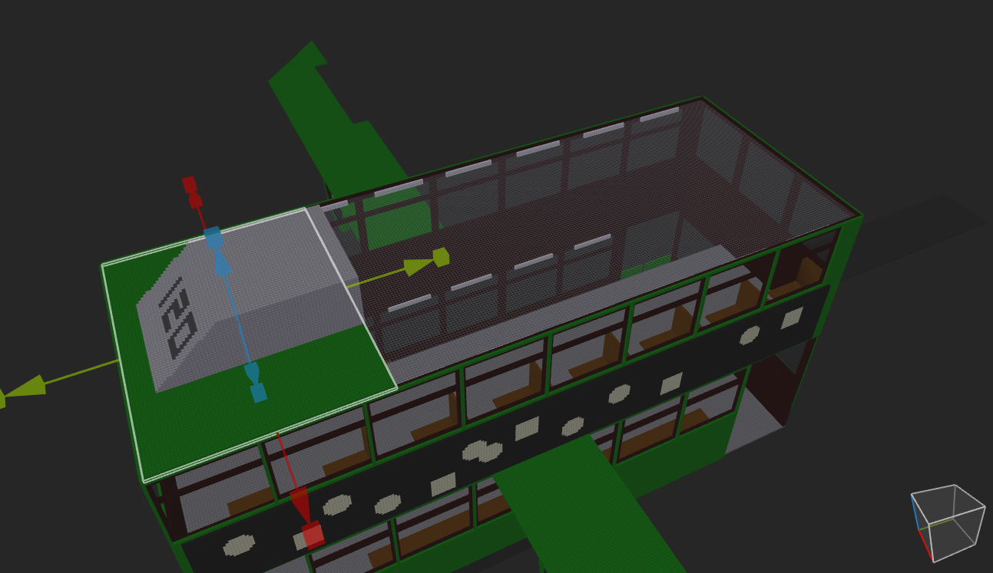
Tram Asset
Flying Tram

Slide 2
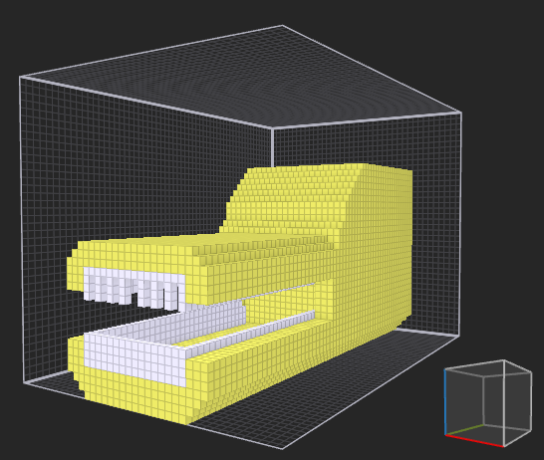
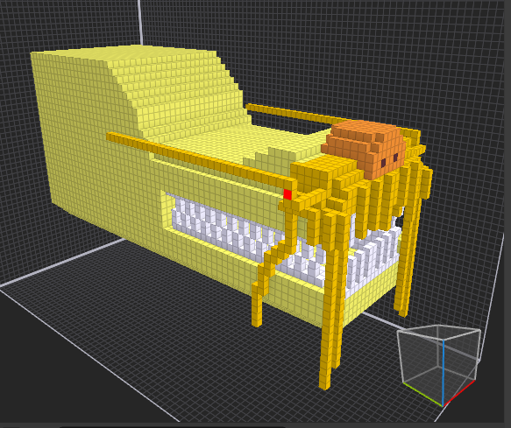
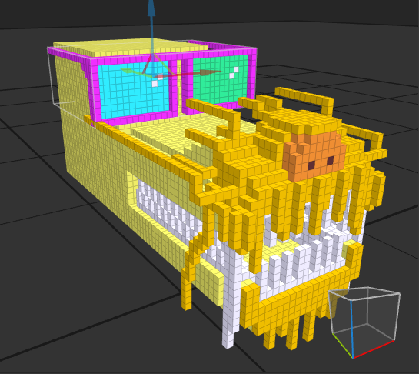
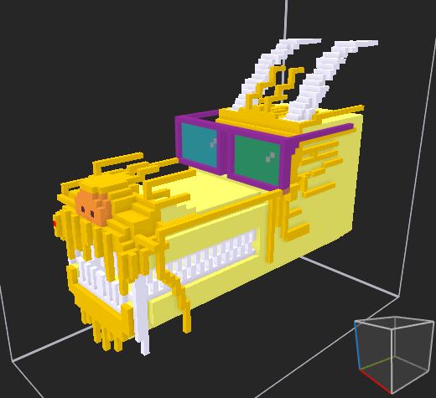
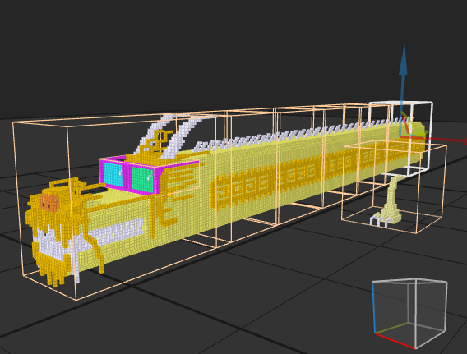
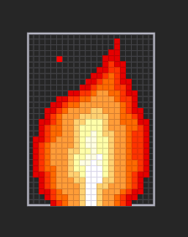
Tram Asset
Cool Dragon + Fire

Slide 3
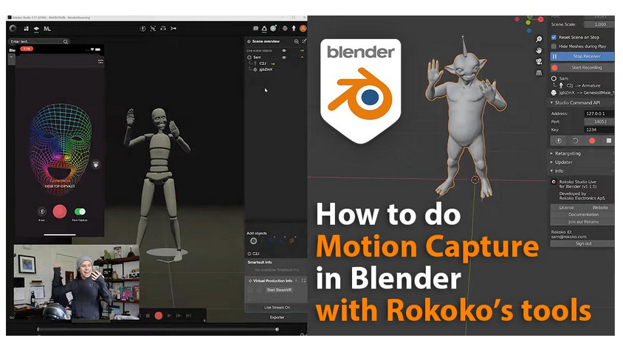
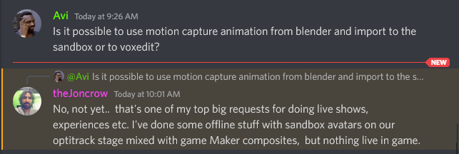
Question from last session:
Motion Capture (Movements) -> Bring the animation to Blender.✅
https://www.3dblendered.com/blender-tutorials/how-to-do-motion-capture-in-blender-with-rokoko-tools/
Bring the animation from blender to sandbox. ❌

Slide 4
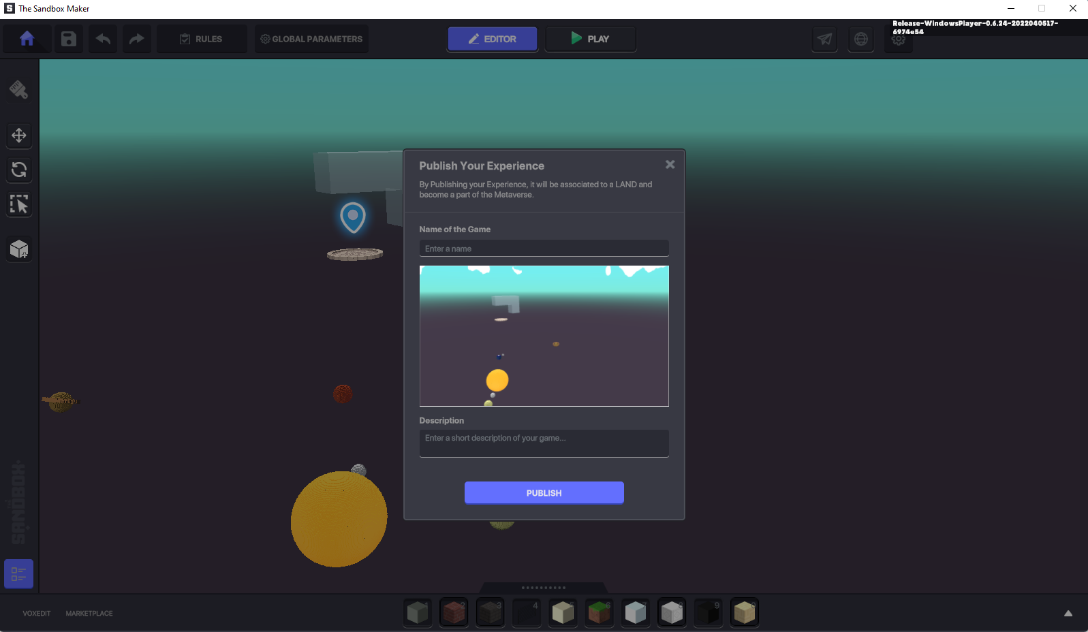
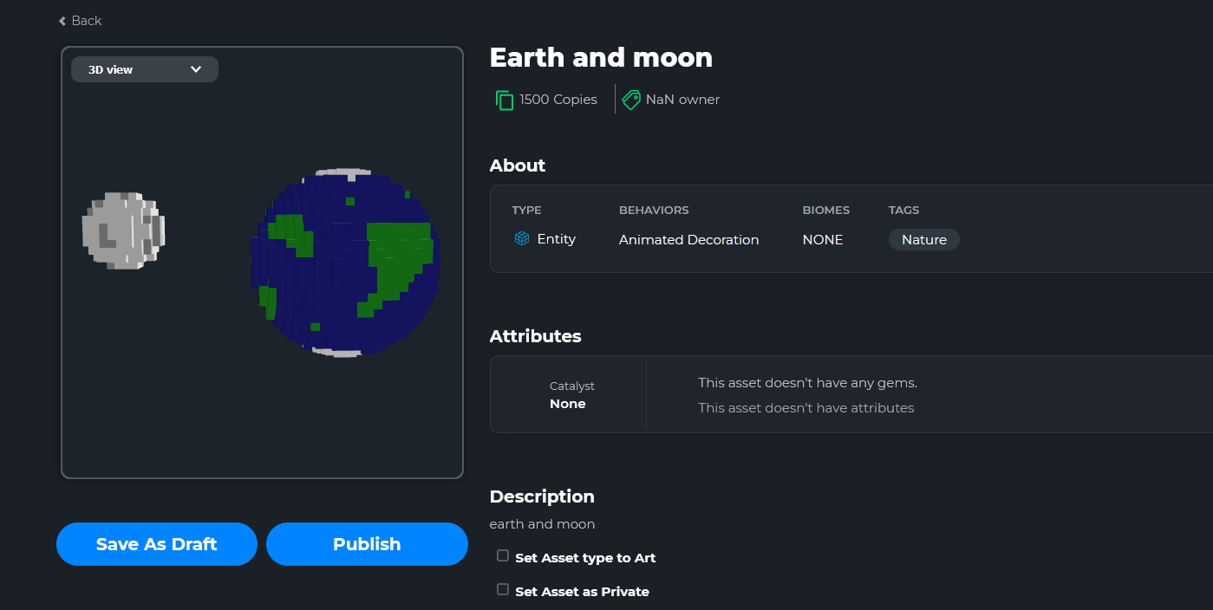
Assets Publish
Users are now able to publish their assets. Which enables users to share and publish their experiences. Need to purchase land in metaverse to host the experiences and enable other users to visit the land.

Slide 5
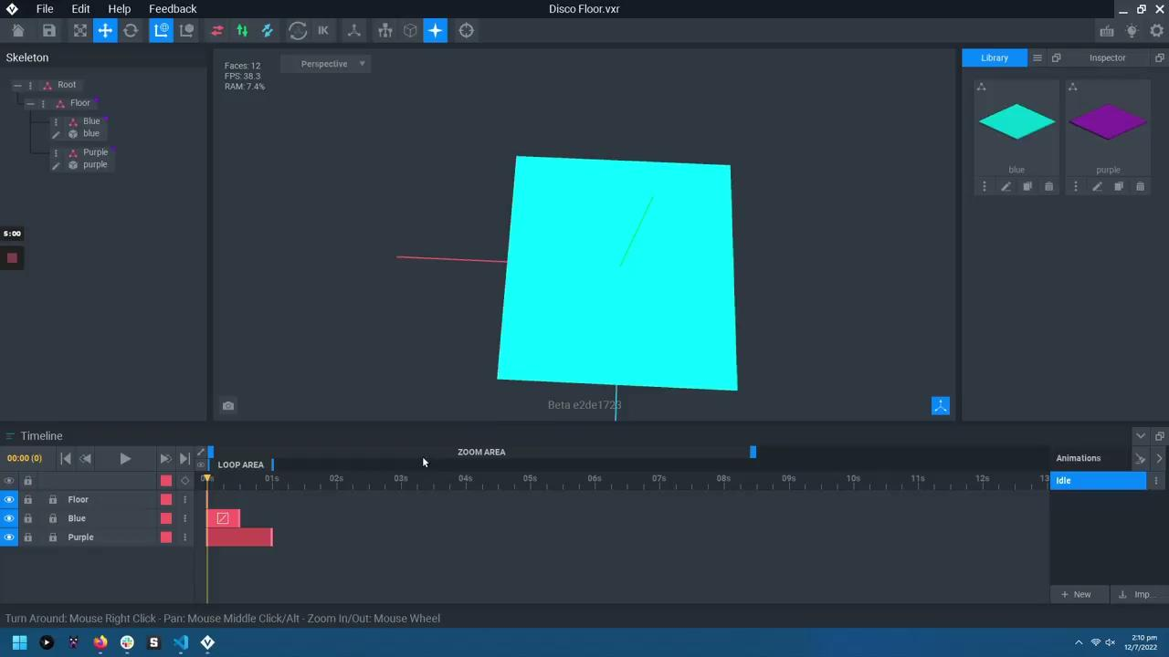

Disco Floor

Slide 6
Toy Boat

Slide 7
Exercise Bike

Slide 8
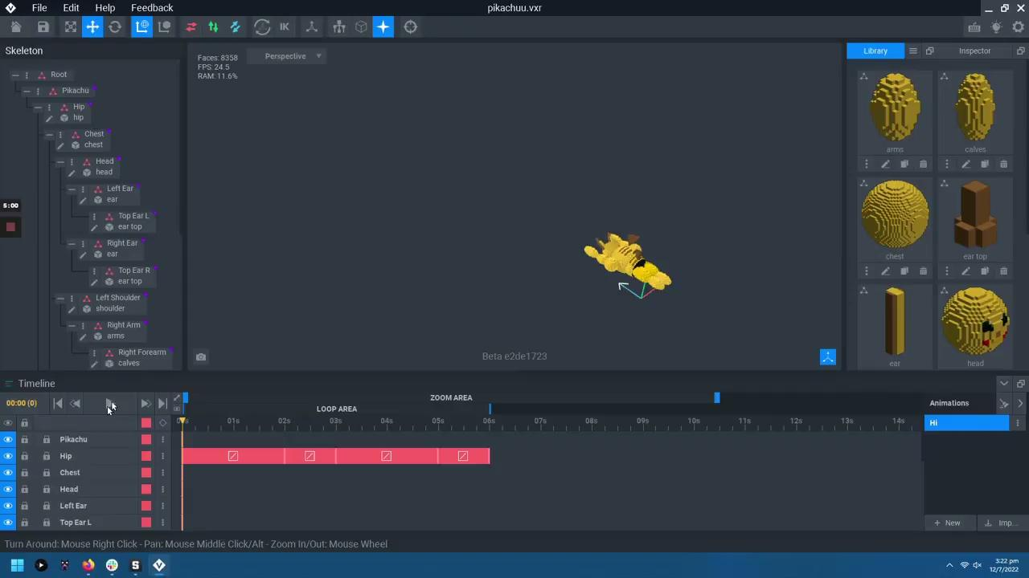
Pikachu Animations

Slide 9

Pokemon Gym

